Slide 1
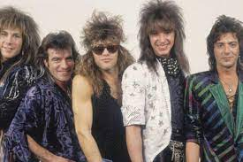
Zoning Trends and Best Management Practices
By:
Siana Law PennFuture
Michael G. Crotty, Esquire & Brigitte M. Meyer, Esquire
Eric M. Brown, Esquire

Slide 2
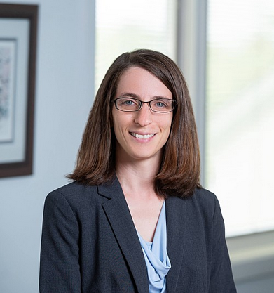
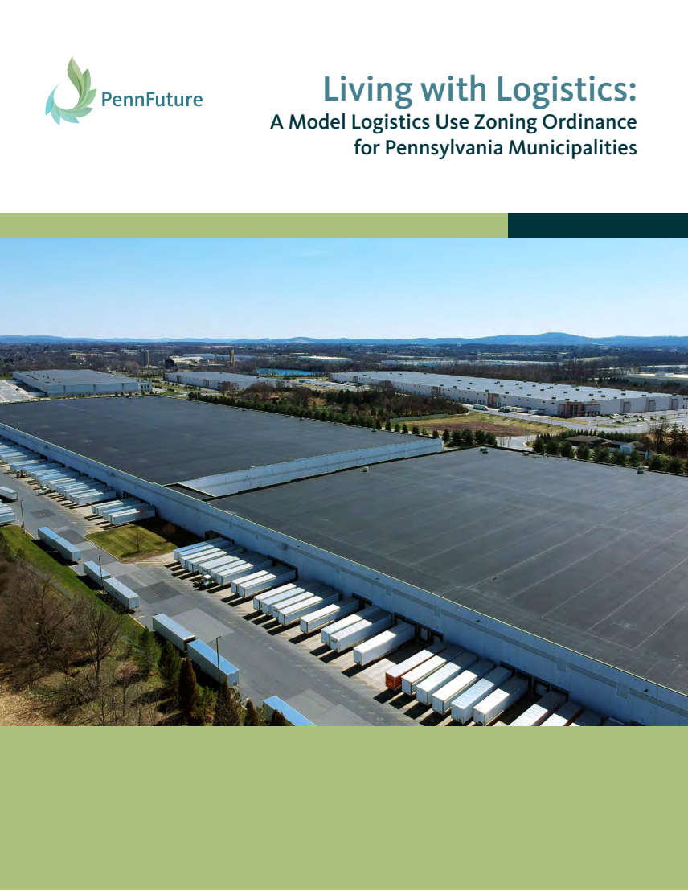

Brigitte Meyer
PennFuture Staff Attorney
Brigitte is a Staff Attorney in PennFuture’s Pocono Office.
Brigitte’s work focuses on water quality and watershed protection, special protection waters, and stormwater management.
Prior to joining PennFuture, Brigitte was an Associate Attorney at Siana Law in Chester Springs, Pennsylvania, where her work focused on municipal and land use law.

Slide 3


Course Presenter
Eric M. Brown, Esquire (embrown@sianalaw.com)
Eric M. Brown is a Partner in the law firm of Siana Law, where he serves in the Firm’s Solicitor, Employment & Labor Law, and Litigation Practice Groups. As part of his work, he counsels municipalities and municipal officials on a broad range of legal issues confronting the daily management of local governments. He has represented municipalities in numerous lawsuits, including Section 1983 civil rights claims, stormwater trespass claims, zoning and land use appeals. He also serves as Solicitor to several Townships, Boroughs and Zoning Hearing Boards.
Eric received his Bachelor of Science degree in Secondary Education from Villanova University and his J.D. from Widener University School of Law. Prior to joining the firm, Eric taught history at a public high school, and held elected office on a local school board.

Slide 4
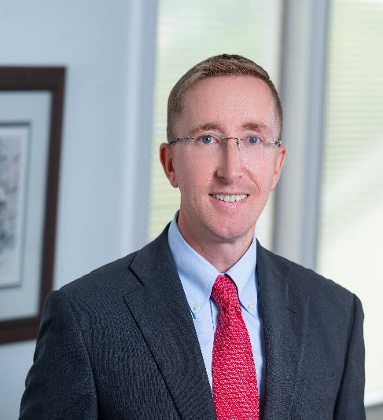
Course Presenters
Michael G. Crotty, Esquire (mgcrotty@sianalaw.com)
Michael Crotty is a Partner in the law firm of Siana Law, LLP. He serves in the Firm’s Litigation and Solicitor Departments, representing municipalities and public officials throughout the Commonwealth. Mike has been recognized as a Pennsylvania Super Lawyer in 2012-2017 (Rising Star) and again in 2022 and 2023 for his work in municipal representation.
He received his Bachelor of Arts degree in Political Science from the University of Michigan in 2000, and his J.D. from Villanova School of Law in 2003. Mike has conducted numerous seminars for local public officials and solicitors through PIRMA, the Pennsylvania Bar Institute, the Pennsylvania State Association of Boroughs, the Pennsylvania State Association of Township Supervisors, and various county associations of township/borough officials.
Mike has had the pleasure of serving on the Delaware County Chamber of Commerce’s Government Affairs Committee, as Chair of the Upper Providence Township Planning Commission and as Chair of the Chester County Bar Association Municipal Law Section.

Slide 5
Overview in Zoning Trends
Living with Logistics Centers
Solar Farms/Alternative Energy
Agritainment and Agritourism
Housing, Affordable Housing and Short Term Rentals
Urban Ag and Residential Ag Accessory Structures

Slide 6
Best Practices
Planning and Zoning Ordinance review are a never-ending process
  Yearly or biannual audit of zoning
  Keep a running list of ordinance issues
  Common waivers
  Common variances requested
Engage the Planning Commission
Consider a Land Planner familiar with the Borough
Codify!

Slide 7
Best Practices
Zoning Ordinance as a living document – not static!
Zoning Ordinance – Catchall Provision as savior?
  Depends on how written
  Where to put?

Slide 8
Recent Trends
Solar Farms

Slide 9
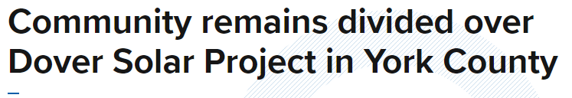
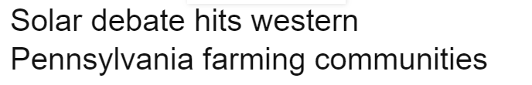
Solar Farms
      Substantial increase in demand for solar farm projects, many on ag properties
      Farm and Dairy Daily: “Majority of Local Zoning Codes in PA Lack Guidance on Solar” – 87% as of 2021
      2021: Being studied by Legislative Cttees for PA Agriculture and Rural Affairs and before the Local Government Committee
      Pending legislation to “eliminate local barriers to on-site solar”

Slide 10
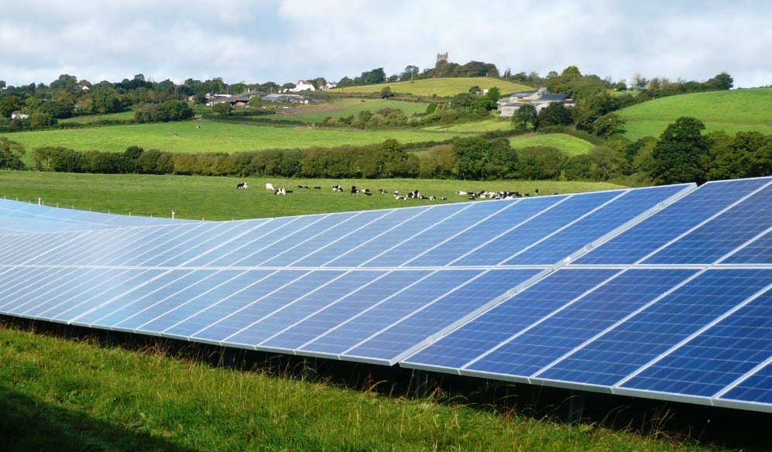
Solar Farms
      Ordinance and Planning Considerations
        Where: Whether to allow on Agricultural Properties; minimum lot sizes/max lot sizes?
        How: Permitting process (as it may not trip land development)?
        What:
          Glare protections and Buffering
          Compatibility with agricultural use
            & accessory to it?
          Whether treated as impervious?
          Decommissioning procedures and security $$$

Slide 11
Solar Farms
      ACRE Considerations
        Is a solar array for off-site consumption part of a “normal agricultural operation”?
        No controlling authority.
        Necessary support component to ag operation vs. separate, distinct use from the farming/ag operation
        1 ACRE complaint “pending review”

Slide 12

Solar Farms
      Not always Presented as Accessory to Farms!
      Northampton Area School District v. Lehigh Township ZHB: 2013 Commonwealth Court decision
        School sought to use 4 of 19 acres for solar array field as “accessory use”
        7,000 solar energy panels to “support the existing school use” (on-site use only, cost savings for school, plus educational component)
        ZO denied as second commercial use and School appealed to ZHB. ZHB upholds the ZO.
        Cmwlth Ct: Solar use allowed under accessory use language which allowed on-site solar generally. Ct leaves open whether solar panels for off-site generation may be a principal use allowed under zoning.

Slide 13
Agritainment/Agritourisim

Slide 14
Agritainment/Agritourism
Diversification of farming to promote additional revenue streams.
Means of preserving farms.
  Bed and breakfasts.
  Farm Markets and pick-your-own.
  Corn mazes, child activities/playgrounds, movie nights, hayrides and other amusements.
  Sale of food, wineries, breweries and other beverages.
  Live bands and music.
  Wedding and banquet facilities.
Zoning Ordinance often not-up-to-date and competing planning interests
  Should any of the above be considered accessory or principal?
  By right vs. conditional use?

Slide 15
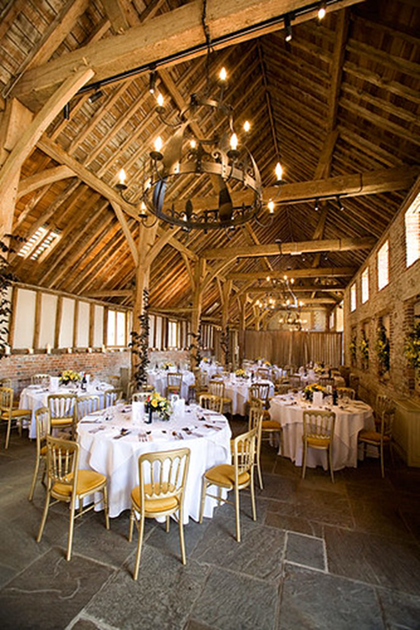
Agritourism/Agritainment/Wedding Barns
      What land use problems arise from them?
        How to define
        Noise
        Traffic
        Parking
        Commercializing otherwise rural, ag/residential areas
        Loss of farming vs. Supporting farming
        Policing

Slide 16

CASELAW – SPECIFIC CHALLENGES
      Whether an agritourism/agritainment/wedding barn use is one that is an accessory use or central component to an agricultural operation??
      Geiselman v. Hellam Township BOS: 2021 Commonwealth Court Decision
        Cmwlth Ct held that broad language of winery included ability to have “party-type” events and agritourism gatherings, consistent with the ruling from the Township.
        Cmwlth Ct declines to “second-guess” the local Township in interpretation of its ordinance.

Slide 17
CASELAW – SPECIFIC CHALLENGES
      Other caselaw
      Monroe Township v. Sollenberger (Pa. Cmwlth 2020) – zoning enforcement action. Landowners started barn wedding use without any Township permits. Not permitted in the Zoning District. Ct upholds Township enforcement.
      Leinberger v. Lynn Township ZHB (Pa. Cmwlth 2016) – proposal to restore existing barn on property for banquet/wedding/meeting venue. Ordinance required direct road access to higher level of road, not provided here. ZHB held that direct access was provided; Cmwlth Court disagreed and reversed approval.

Slide 18

Living with Logistics
Addressing Modern Distribution and Fulfillment Centers Through Zoning

Slide 19

What is Logistics?
Logistics refers to the part of the supply chain that deals with the acquisition, storage and distribution of goods.
Since the advent of online ordering and direct-to-consumer shipping, the logistics industry has shifted from long-term bulk storage warehouses to distribution and fulfillment centers that focus on shipping.

Slide 20
Where is this happening?
Logistics developers prefer areas that have:
Abundant, inexpensive, available land
Access to transportation infrastructure such as highways, rail and air hubs
Proximity to major population centers
Availability of labor, particularly non-union labor
Favorable local regulations and taxation

Slide 21
Impacts of Logistics Facilities
Massive modern logistics facilities:
Often convert large swaths of natural ground cover to impervious surface → increased stormwater runoff, pollution, destruction of habitat, heat islands
SO MANY TRUCKS → diesel emissions, traffic, wear and tear on roads
Noise, light, aesthetic impacts

Slide 22

The Solution
Better regulation of logistics uses can be accomplished through zoning ordinances

Slide 23
The Solution
Better regulation of logistics uses can be accomplished through zoning ordinances
Operative word is “can.” In reality, many existing zoning ordinances are not doing a great job of this

Slide 24
Problems We’ve Seen
Biggest problem: Bad definitions
Many zoning ordinances define “warehouse” and “distribution center” and impose stricter requirements on distribution centers.
BUT, definitions are written so that the distinction is not totally clear and/or so that information about the end-user’s operations is necessary to classify the use

Slide 25
?
Biggest problem: Bad definitions
This creates problems because most logistics development is done “on spec.” This means developers build facilities without knowing exactly who will ultimately occupy them or what they will be used for.
Even if a facility has all the earmarks of a distribution center (enormous, dozens of truck loading docks), developers can claim it’s “just storage.” Without information about the end user, municipalities can’t refute this.

Slide 26

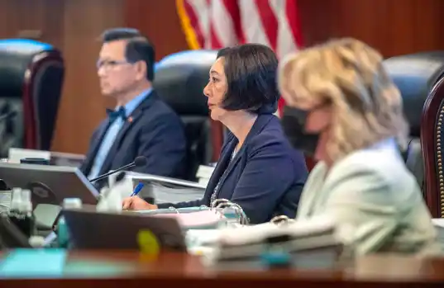
Municipal Officials
Developer
Your plan shows a 400,000 sq. ft. building with 97 loading docks. You’re saying it’s just for storage?
Yep. Storage only. I promise.

Slide 27
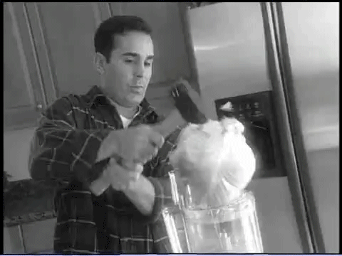
There Has to Be a Better Way!!

Slide 28

Enter PENNFUTURE MODEL ORDINANCE!

Slide 29

Key Features of PennFuture’s Model Ordinance
New and improved definitions!
Unlike typical ordinances, which define uses based on internal operations, our use classification depends on size and ability to generate traffic.
This is because these characteristics can be easily discerned or calculated at the municipal approval stage based on plan drawings and generally accepted calculation methodology. Don’t need info about end user.
Less need to parse definition terms means fewer loopholes

Slide 30
Key Features of PennFuture’s Model Ordinance
More Robust Regulations!
Imposes restrictions intended to mitigate impacts of logistics facilities, including:
Limitations on woodland disturbance
Riparian buffer requirement
Pervious pavement credit
Setback, landscaping buffer and berm requirements
Noise and light restrictions
Truck-intensive uses must be located in close proximity to highways and provide amenities for truck drivers, including overnight parking

Slide 31
Key Features of PennFuture’s Model Ordinance
Regulations Tailored to Impacts!
Large facilities (>25,000 sf) subject to restrictions intended to mitigate size impacts (e.g. landscape buffer, berm)
Traffic-intensive uses subject to requirements intended to mitigate traffic impacts (e.g. must be located near highway)
Facilities that meet both size and traffic thresholds are required to meet both sets of requirements
Certain requirements apply to all uses (e.g. riparian buffer, woodland disturbance)

Slide 32

Take our Model Ordinance and get a GUIDEBOOK absolutely free!*
* Baking soda not included

Slide 33
Key Features of the Model Ordinance Guidebook
Siting Logistics Uses
Every municipality is different, so we cannot provide model ordinance provisions as to where logistics uses should be permitted.
Instead, the Guidebook offers factors municipalities should consider when choosing where to allow them, including:
Cumulative impacts and environmental justice (EJ) areas
Proximity to sensitive natural features
Compatibility with nearby uses
Access to highways and other modes of transportation
Capacity of existing infrastructure (water, sewer, roads) to handle heavy use
Notes:
Environmental justice areas are areas that have certain characteristics that, historically, have been associated with disproportionate exposure to negative environmental impacts.

Slide 34
Key Features of the Model Ordinance Guidebook
Level of Review
The Guidebook strongly encourages municipalities to designate logistics uses as conditional uses or special exception uses.

Slide 35
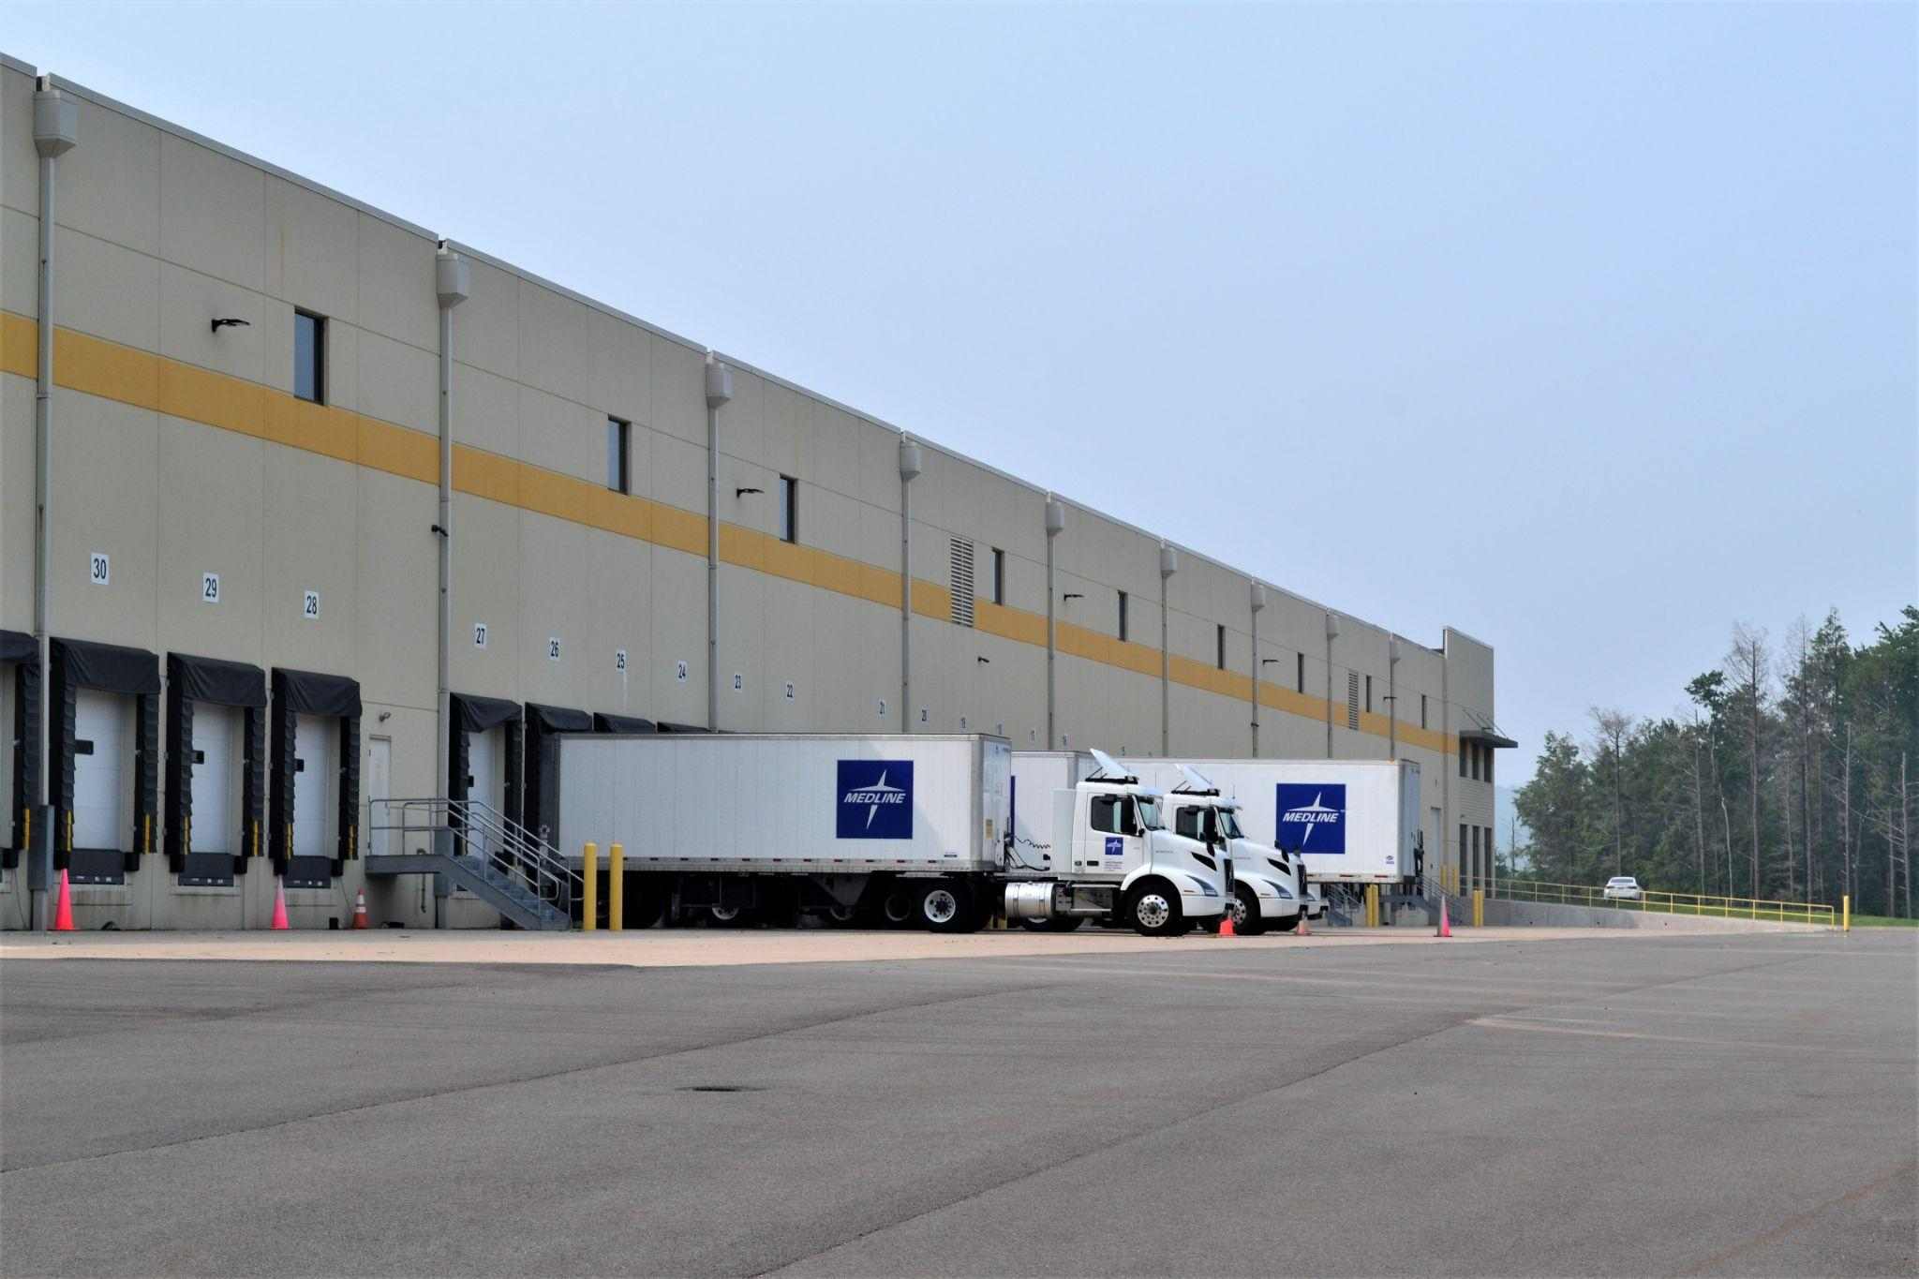
Key Features of the Model Ordinance Guidebook
Additional Features
Information about the logistics industry
Explanation of PennFuture’s proposed ordinance provisions
Fun photos of logistics facilities →

Slide 36
Trends in Housing

Slide 37
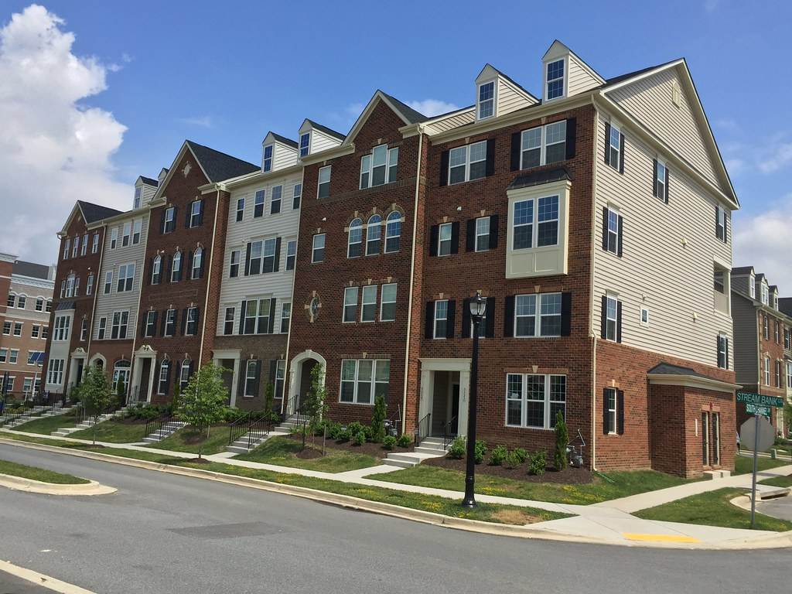
Housing & Affordable Housing, Airbnb and Investment Ownership
  Southeastern PA – housing market with prices still holding on, but sales declining
  PEW Trust: 28% of all single family homes are owned by investment companies (2015 – 15%); declining rates of first time/entry buyers
    Why?
      Mortgage interest rate spikes
      Low housing stock (down 6.6%)
      High purchasing competition
      Lure of cash, non-FHA offers

Slide 38
Competing Pressures in the Housing Regulatory Environment
  School Infrastructure
  Road Infrastructure
  Sewer
  Stormwater
  Open space
  Slopes, floodplains, environmental constraints
  Impacts on residential character
  Market Pressures
  Mortgage rates
  Housing Affordability

Slide 39
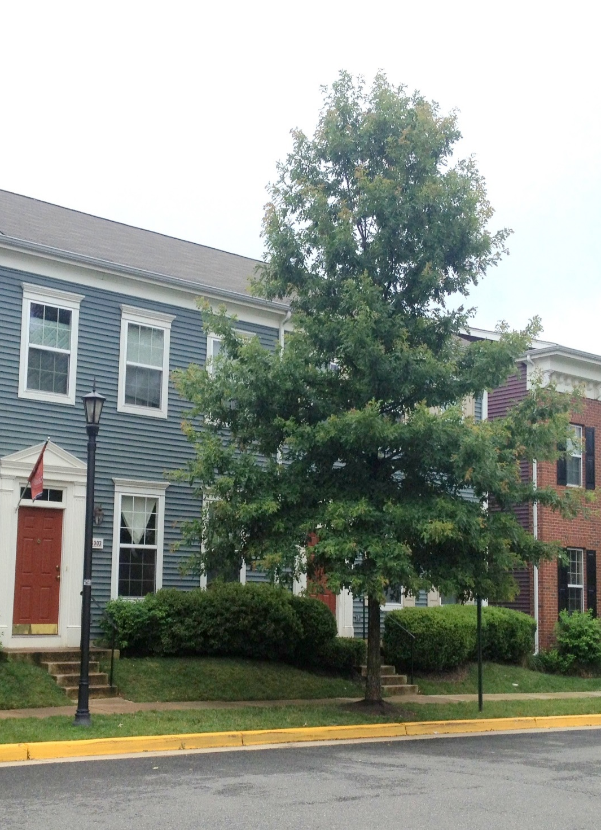
Barriers and Challenges to Affordable Housing
  How to incentivize, define and regulate “affordable housing”
  Monetary incentives for developers?
  Who pays for aging municipal infrastructure (sewer, stormwater, water, roads, etc.)
  Multifamily housing and Townhomes no longer the “solution” to affordability
    3 BR, 2 ½ bath, 2000 square foot TH
    “Priced from $660,090”

Slide 40
Barriers and Challenges to Affordable Housing
  Inability of municipalities to regulate the form of property ownership (Corp. vs. LLC vs. natural person). PA General Energy Co., LLC v. Grant Township, 139 F.Supp.3d 706 (W.D. Pa. 2015)
  Solutions often focus on new development

Slide 41
Byproduct Trends of the Housing Issues
  Push for more multi-family housing
  Short Term Rental Uses
  Accessory Dwelling Units (ADUs)
  If you want to allow/incentivize/control it, zone for it.

Slide 42
Airbnb / Short Term Rental Uses
      Slice of Life v. Hamilton Township ZHB - “The Airbnb Case”
      Not Airbnb
      Not an ordinance validity challenge … but impacts how Zoning Ordinances are to be interpreted and therefore validity challenges
      The background:
      1985 Zoning Ordinance
      Commonly used definitions of single housekeeping unit/family/dwelling/etc.
      ZO does define and regulate hotel and motel
      The Decision:
      Full-time short term rental use does not qualify as single family
      dwelling unit. Unless the use is specifically included, it is not permitted.

Slide 43
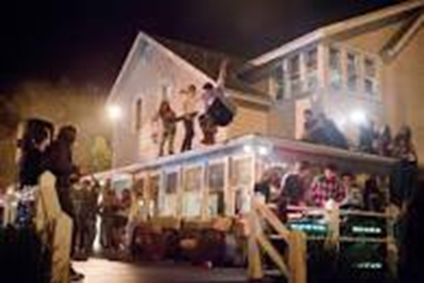
Airbnb / Short Term Rental Uses
        Shvekh v. ZHB of Stroud Township, 2017
        Marchenko v. ZHB of Pocono Township, 2016
          Each involved home that was partly-used for the short-term rentals and partly used by the owner
          Not dq’d as single family dwelling unit definition
            Findings: Both uses allowed because not specifically prohibited
        Slice of Life – Supreme Court – 2019 - a home used exclusively as a short-term rental did not qualify as a “single family dwelling unit” and was therefore not permitted.
        Leinberger v. Stellar, 2020 – 30% rental/70% family use qualified as single family dwelling unit of second DU on property
Headline: Airbnb renters destroy family’s house after hosting ‘drug-induced orgy’

Slide 44
Airbnb / Short Term Rental Uses
        If you want control over it, explicitly regulate it in your Zoning Ordinance:
        Where allowed
        Inspection requirements and Permit Requirements
        Parking
        How allowed – by right, special exception, conditional use?
        Emergency contact information
        Three strikes and other enforcement measures
      Would the New York City model work for a PA municipality??

Slide 45
Urban Agriculture
& Residential Ag Accessory Structures

Slide 46
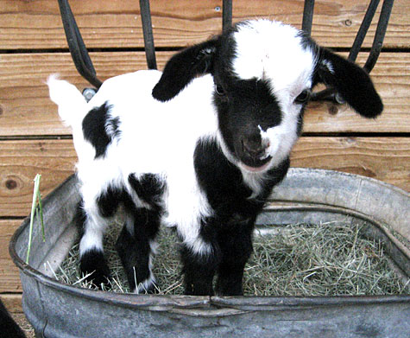
Urban Agriculture
      Agriculture as permitted principal use or accessory use in urban areas
      Expanding Accessory Uses:
        Bees
        Chickens
        Horses and Mini-Horses
        Geese
        Mini-Goats
        Ducks
        Cultivating/growing produce

Slide 47
Urban Agriculture
      Common Locations of Activities:
        Backyards of residential lots
        Rooftops, decks, patios, windowsills
        Vacant private or public land
        Community gardens, greenhouses
        Land surrounding public institutions like schools
      Common regulations – do they apply to each equally?
        Example: grazing acreage minimums, accessory structure setbacks
      Impact of Emotional Support Animals/Americans with Disabilities Act?

Slide 48
Urban Agriculture
Common Concerns:
  Traditional zoning ordinances frequently (and sometimes unintentionally) prohibit:
    Residents from raising farm animals in urban areas
    Growing produce on certain parcels
    Selling products from urban farms

Slide 49
Urban Agriculture
Comprehensive Planning and Zoning to encourage urban farming in appropriate zoning districts.
Zoning
  Define “urban agriculture” uses – “small scale cultivation of fruits, vegetables, flowers, nuts and like products as well as raising farm animals.”
    Home Gardens vs. Community Gardens v. Commercial Garden vs. Urban Farm
  Provide urban ag zoning district (or overlay) to permit ag use as principal or accessory use in certain locations, subject to clear standards.
  Amend “home occupation” to explicitly permit either the off- or on-site sale of goods produced by the farm and outside employees with reasonable restrictions.
  Balance nuisance concerns to protect the rights of neighbors.

Slide 50
Urban Agriculture
Identify Size Limits
Specifically allow use and sale of products
Landscaping
Fencing
Signage
Parking
Additional operating rules and standards
  E.g.,. Performance standards to integrate activities into local neighborhood, operating hours, equipment use, application of chemicals, waste and composting, watering, pruning, removal of dead or diseased plant material

Slide 51
Bees (Apiary) Model Ordinance
Require Annual permit
Require compliance with Department of Agriculture Best Management Practices
Require “Flyway” Barrier
  Barrier composed of dense vegetation or man-made materials to direct bees quickly into the sky.
Water – Require fresh supply in close proximity to hive
Setbacks
Define and prohibit “nuisances”
Hatfield Borough, Montgomery County – Good Example

Slide 52
Chickens – Model Ordinance
Annual Permit
Bulk and lot requirements
Maximum number of chickens
Setback minimums
Appearance & location of henhouses/coops (vs. chicken pens?) Free-range?
Identify zoning districts permitted
Prohibition against roosters?
On site slaughtering of chickens? Location? (indoors or outdoors)
Identification banding

Slide 53
Zoning Trends &
Best Management Practices
Questions

